Slide 1
BAROQUE ART
History of Western Art
BFA-II (Visual Arts)
Course Incharge: Ms. Farah Khan
Institute of Design & Visual Arts (LCWU)

Slide 2
Baroque art & its history
The term Baroque comes from the Portuguese word Barroco, used to refer to the pearls of irregular shapes; basically, the ugly pieces. In the late 18th-century, this word started to be used for referring to the artistic period. It was adopted with a negative connotation, criticizing the exuberance of Baroque that didn’t appeal of any beauty to the artists of the time.
The Baroque period in art history started at the beginning of the 17th century and continued to evolve until the 18th century. It started in Italy but spread to most countries of Europe, and to the colonies in the America.
The Baroque touched almost all forms of art. It was particularly celebrated in the visual arts like painting, sculpture, and architecture. However, other forms of art like theater, music, and dance were also transformed during this time.
The style of Baroque was exuberant and was characterized by a dramatic realism. There was an intention of creating a strong sense of movement by using different shapes and colors. It was common to use diagonals, curved lines, and abundant colors. The contrast of light and dark was another common feature. There was an attention to detail, and every element was treated to be of stunning beauty. Artists didn’t hesitate to incorporate ornamentation and embellishments.

Slide 3
Baroque art & its history
There was usually a combination of different arts to enhance the dramatism. Painting, sculpture, and architecture were often created together. Sometimes, the representations were so vivid that they seemed to become real and jump into the real world.
Other forms of arts also became elaborate and ornamented. Theater plays had complex plots and characters with many unexpected turns. Baroque music was dramatic, and the opera started during this time.
The Baroque started as a response of the Catholic Church to the many criticisms that arose during the Protestant Reform in the 16th-century. The seat of the Catholic Church in the Vatican saw in art an opportunity for reconnecting with the people.
The Catholic Church: In 1517, Martin Luther started a protest against the Catholic Church, complaining about the corruption and abuse of power among the clergy. This was the beginning of the time known as the Reformation and Protestant Christianity. Most of the 16th-century was marked by religious conflicts.

Slide 4
Baroque art & its history
This situation led the Vatican to establish a permanent conference of high-rank clerics. It was held between 1545 and 1563 and was named the Council of Trent, after the Italian city where it took place. Among the many discussions, the council condemned the reforms and the emerging Protestantism. The administrative structure of the church was reviewed and many aspects of modern Catholicism, like the sacraments and clerical celibacy, were reaffirmed. The pedagogical purpose of artistic images and adoration of saints and relics was also discussed and recognized, so these continued to be promoted as an important part of artistic representations. The time of the council and the wars against Protestantism became known as the Catholic Counter-Reformation.
By the end of the century, the Catholic Church actively tried to connect more with society. The intellectual searches of Renaissance art were understandable only by the educated people, so the church wanted a more realistic and emotional art. The idea was to reach the uneducated majorities through emotions evoked by art.
The dramatic and elaborate style of the Baroque not only provided a sensorial experience but also became a demonstration of wealth and power. It was initially promoted by the church to educate the faithful, but as statement of power to the protestants.

Slide 5
Baroque art & its history
The Catholic Church enthusiastically embraced the religious power of art. The visual arts, the Church argued, played a key role in guiding the faithful. They were certainly as important as the written and spoken word, and perhaps even more important since they were accessible to the learned and the unlearned alike. In order to be effective in its pastoral role, religious art had to be clear, persuasive, and powerful. Not only did it have to instruct, it had to inspire. It had to move the faithful to feel the reality of Christ’s sacrifice, the suffering of the martyrs, the visions of the saints.
The Church’s emphasis on art’s pastoral role prompted artists to experiment with new and more direct means of engaging the viewer. Artists like Caravaggio turned to a powerful and dramatic realism, accentuated by bold contrasts of light and dark, and tightly-cropped compositions that enhanced the physical and emotional immediacy of the depicted narrative. Other artists of the movement, also experimented with realism, ultimately settled on a more classical visual language, inspired by the vibrant palette, idealized forms, and balanced compositions of the High Renaissance. But few turned to daring feats of illusionism that blurred not only the boundaries between painting, sculpture, and architecture, but also those between the real and depicted worlds. In doing so, the divine was made physically present and profound. The 17th century art was meant to impress and deliver truth to inspire the senses of viewers.

Slide 6
Characteristic features of Baroque art
To evoke emotion and passion instead of the calm rationality of Renaissance.
representations of extreme states of feeling,
a desire to suggest extensions into space,
dynamic movement,
an intense engagement with light (in its physical and spiritual connotations)
painterly brushstrokes,
recession of the plane,
open form,
unity,
unclearness of subject.

Slide 7
Main artists of the movement

Slide 8
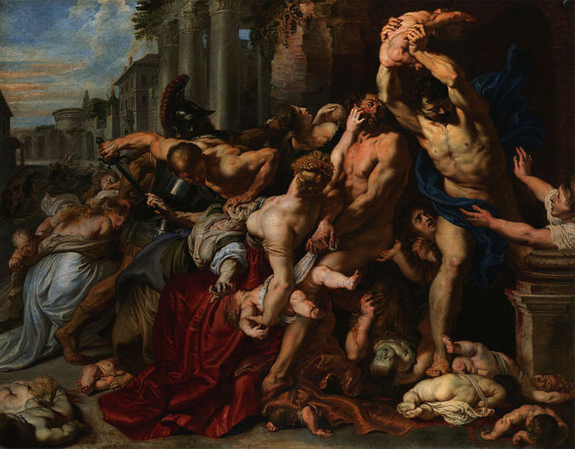
Rubens (massacre of the innocents)

Slide 9
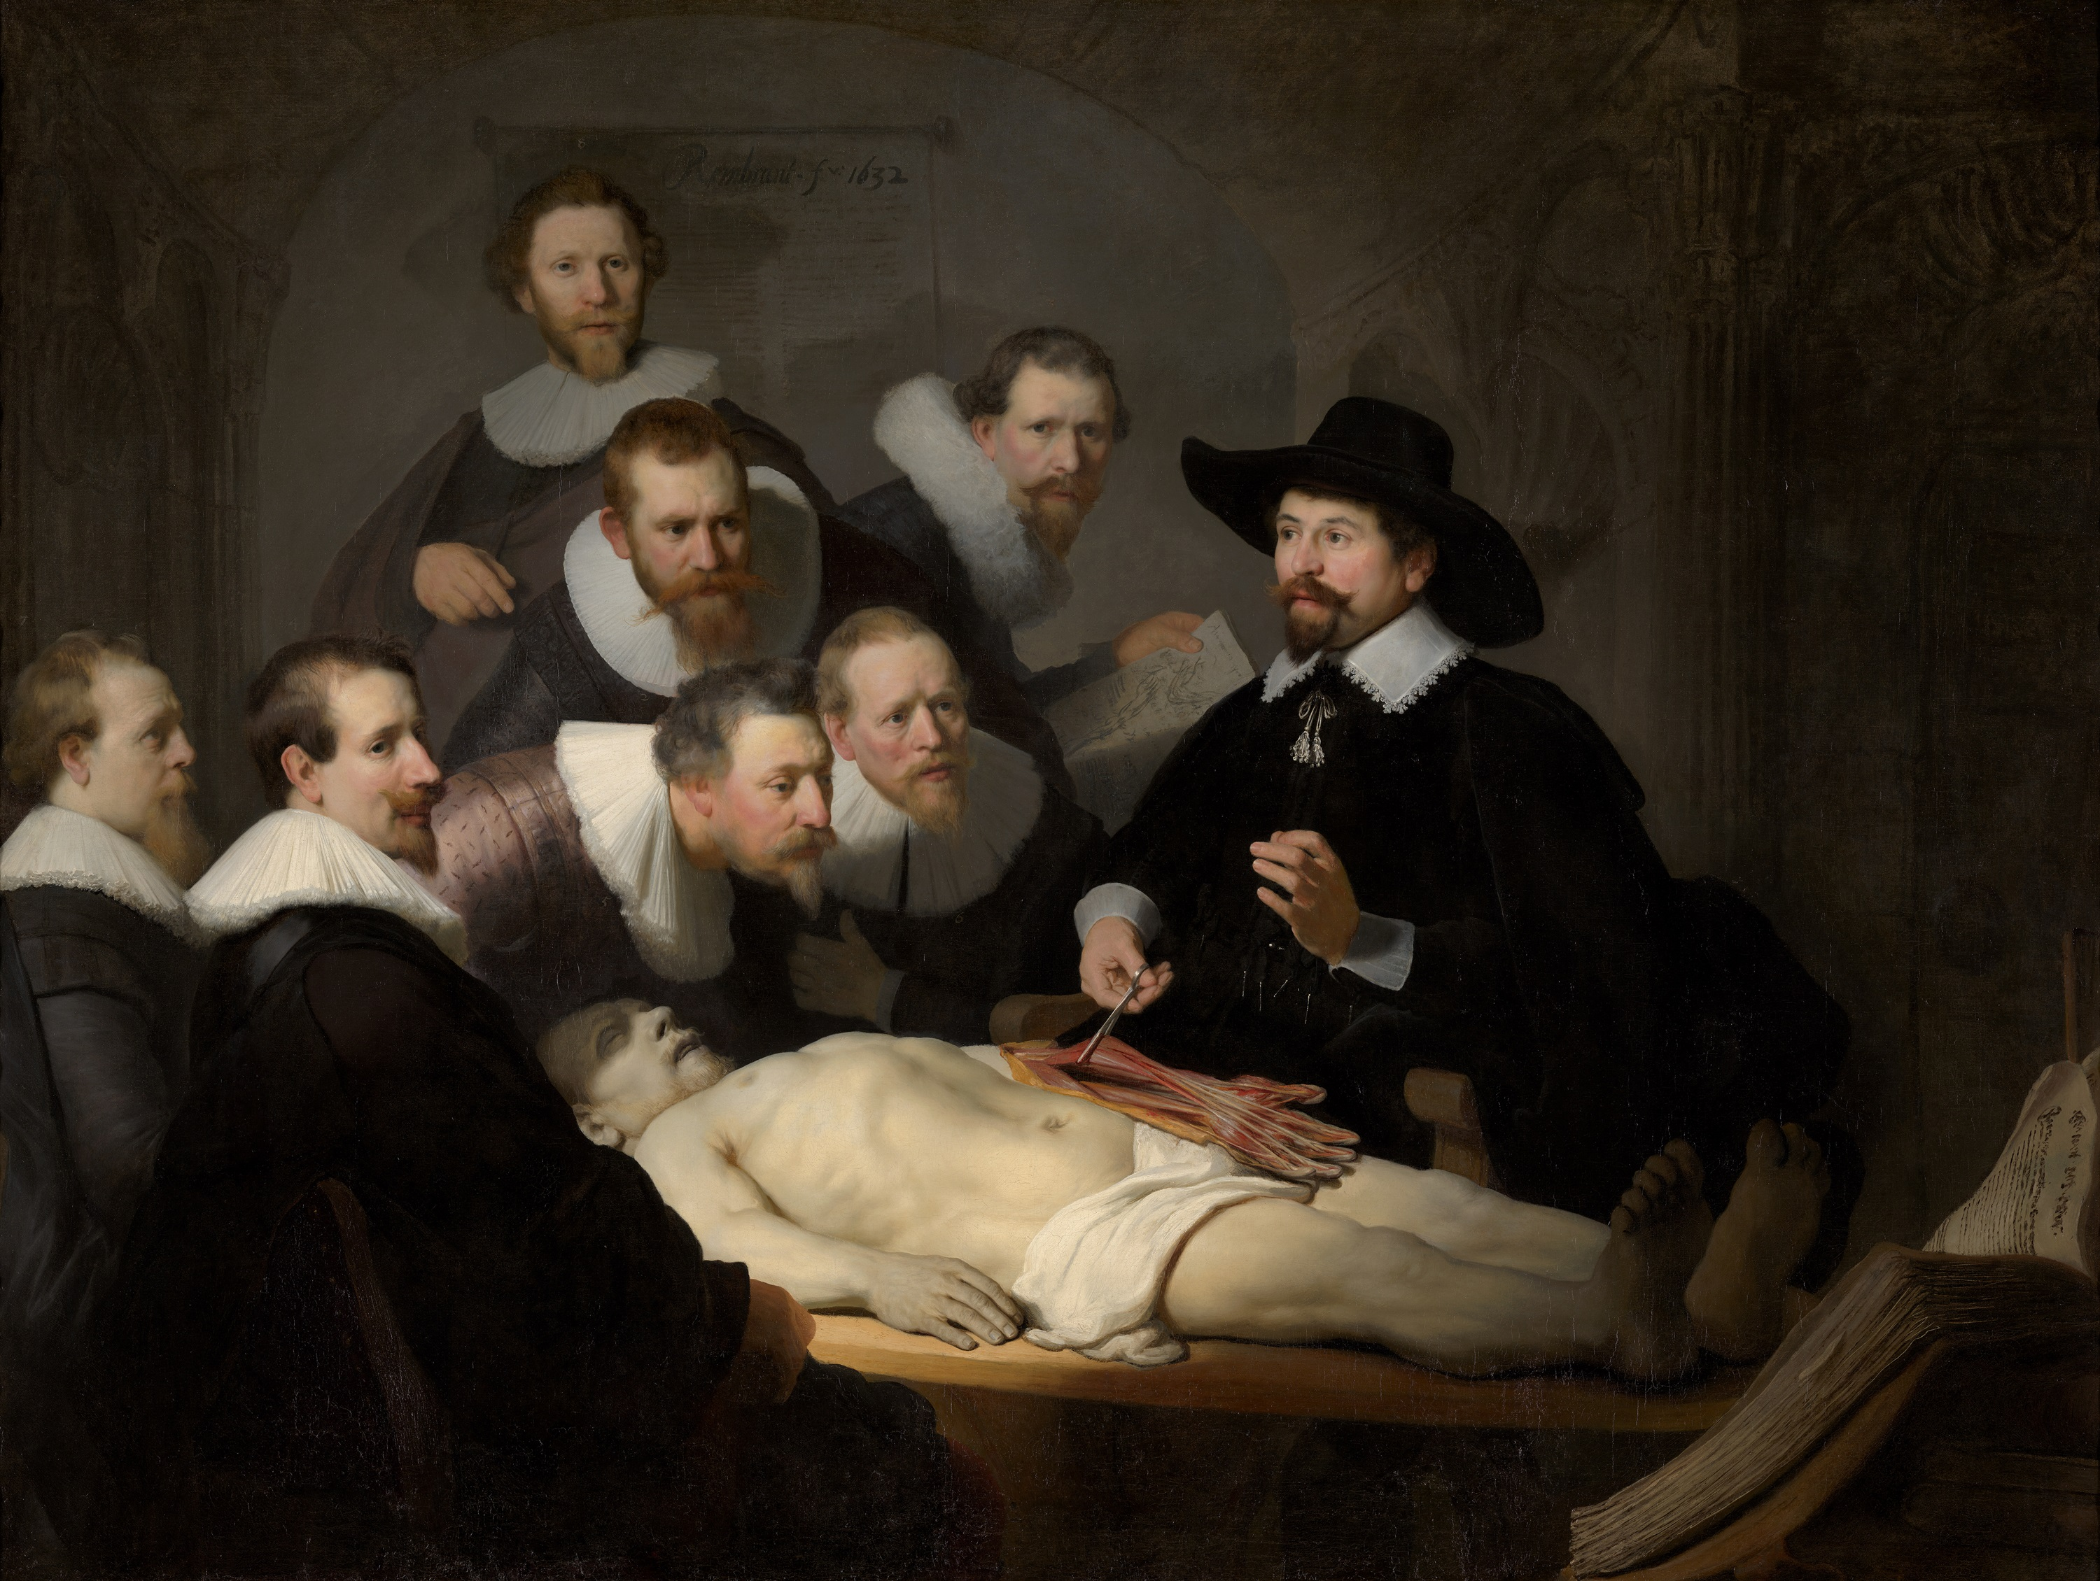
REMBRANDT (ANATOMY LESSON OF DR. TULP)

Slide 10
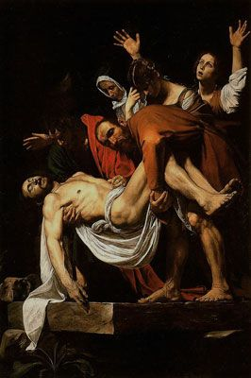
CARAVAGGIO (THE ENTOMBMENT)

Slide 11
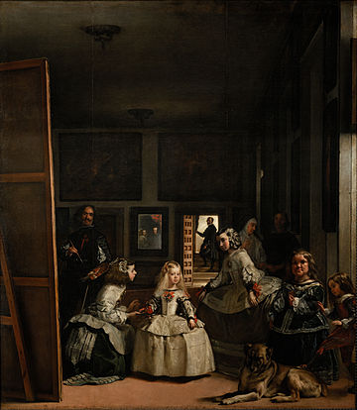
VELAZQUEZ (LES MENINAS)

Slide 12
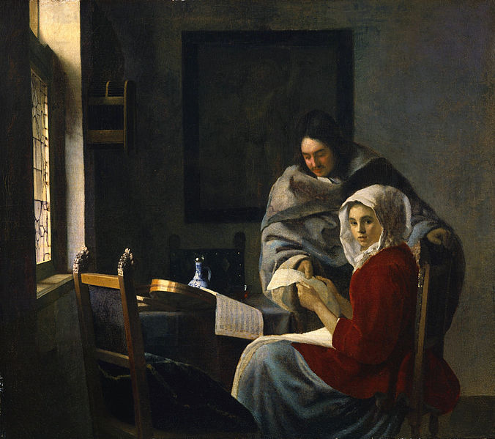
VERMEER (Vermeer Girl Interrupted at Her Music
)

Slide 13
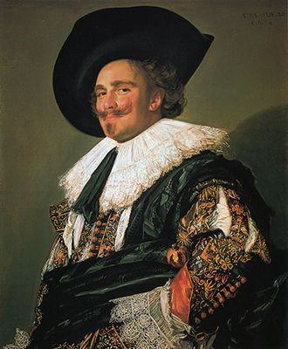
FRANS HALS (THE LAUGHING CAVALIER)

Slide 14
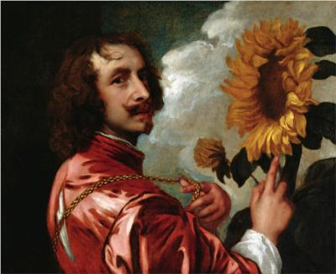
ANTHONY VAN DYCK (SUN-FLOWER WITH A SUNFLOWER)

